Slide 1

6th Grade Accelerated Math
Unit 3, Lesson 9 Operations With Absolute Value in the Real World Volume 1, pg. 122

Slide 2


Benchmark
MA.6.NSO.1.4
Solve mathematical and real-world problems involving absolute value, including the comparison of absolute values.
volume 1, pg. 122

Slide 3
Integrated Mathematical Thinking and Reasoning Standards
MA.K12.MTR.2.1 Demonstrate understanding by representing problems in multiple ways.
MA.K12.MTR.4.1 Engage in discussions that reflect on the mathematical thinking of self and others.
MA.K12.MTR.6.1 Assess the reasonableness of solutions.
MA.K12.MTR.7.1 Apply mathematics to real-world contexts.
volume 1, pg. 122

Slide 4

Learning Target
I can perform operations that involve the absolute value of two numbers.
volume 1, pg. 122

Slide 5

Warm-Up
volume 1, pg. 123

Slide 6
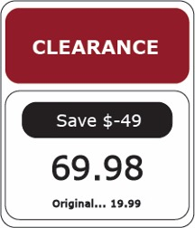
3.9.1 Warm-Up: Math Fail
What do you notice about the sign?
volume 1, pg. 123

Slide 7

Collaboration
volume 1, pg. 123

Slide 8

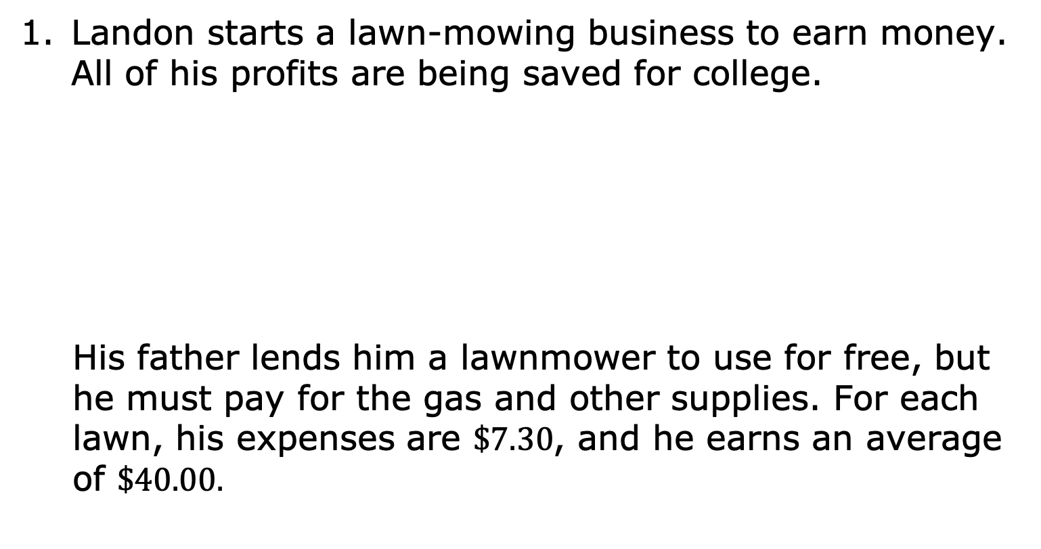
3.9.2 Collaboration: Absolute Value and Profit
Landon starts a lawn-mowing business to earn money. All of his profits are being saved for college.
His father lends him a lawnmower to use for free, but he must pay for the gas and other supplies. For each lawn, his expenses are $\$7.30$, and he earns an average of $\$40.00.$
Profit is the difference between the amount earned (revenue) and the amount spent.
volume 1, pg. 123

Slide 9
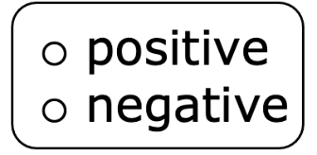
In this situation, revenue is represented with a
value and an expense is
represented by a value.
Write a value to represent each situation.
Landon’s Finances | Value
Expenses per lawn
Revenue per lawn
volume 1, pg. 123

Slide 10
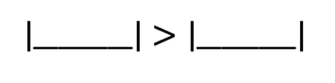

Use an inequality symbol, $<$ or $>$, to compare the absolute values of Landon’s expenses to revenue for each lawn he mows.
How does the inequality show that Landon will make a profit?
volume 1, pg. 124

Slide 11
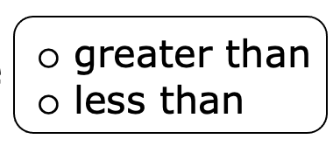
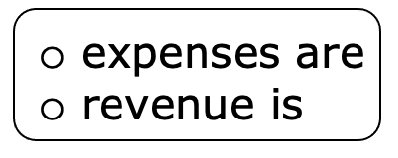
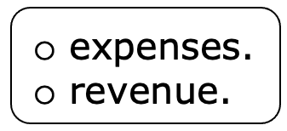
To make a profit, total expenses of a business
must be total revenue. A
business is not profitable when the total
greater than the
volume 1, pg. 124

Slide 12

Guided Instruction
volume 1, pg. 124

Slide 13
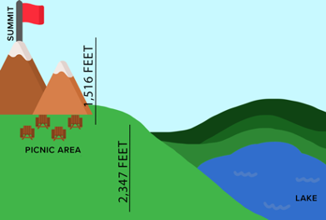
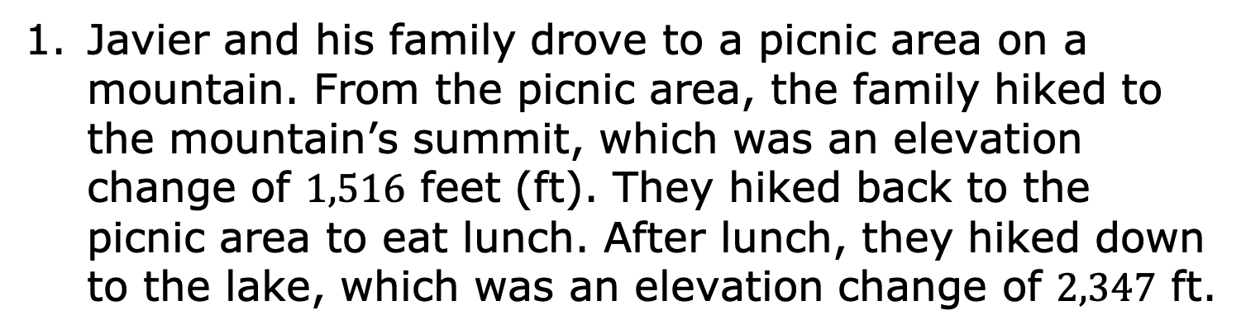
3.9.3 Guided Instruction: Operations With Absolute Value in the Real World
Javier and his family drove to a picnic area on a mountain. From the picnic area, the family hiked to the mountain’s summit, which was an elevation change of $1,516$ feet (ft). They hiked back to the picnic area to eat lunch. After lunch, they hiked down to the lake, which was an elevation change of $2,347$ ft.
volume 1, pg. 124

Slide 14
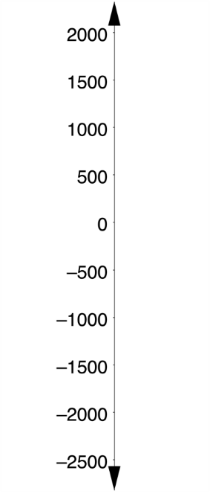
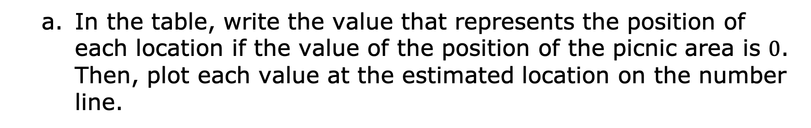
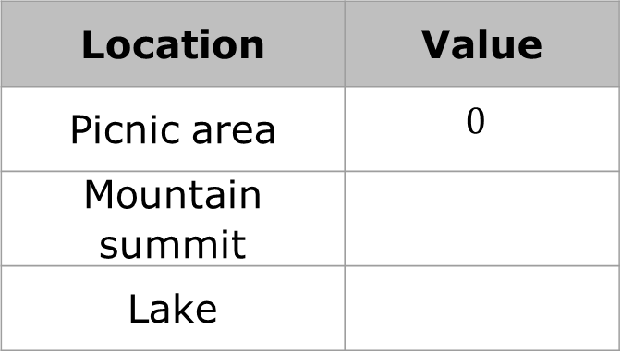
In the table, write the value that represents the position of each location if the value of the position of the picnic area is $0$. Then, plot each value at the estimated location on the number line.
Location | Value
Picnic area | $$0$$
Mountain summit
Lake
volume 1, pg. 124

Slide 15
Represent the distance of each location from the picnic area.
What operation would you use with the representations in the table to find the distance from the lake to the mountain summit?
Location | Distance from Picnic Area
Mountain summit
Lake
volume 1, pg. 125

Slide 16
What is the distance from the lake to the mountain summit?
What operation would you use to determine how much farther a hike to the lake is than a hike to the mountain summit?
How much farther is a hike to the lake than a hike to the mountain summit?
volume 1, pg. 125

Slide 17
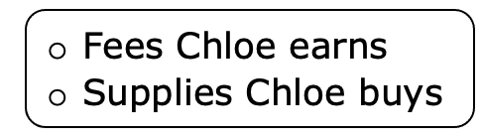
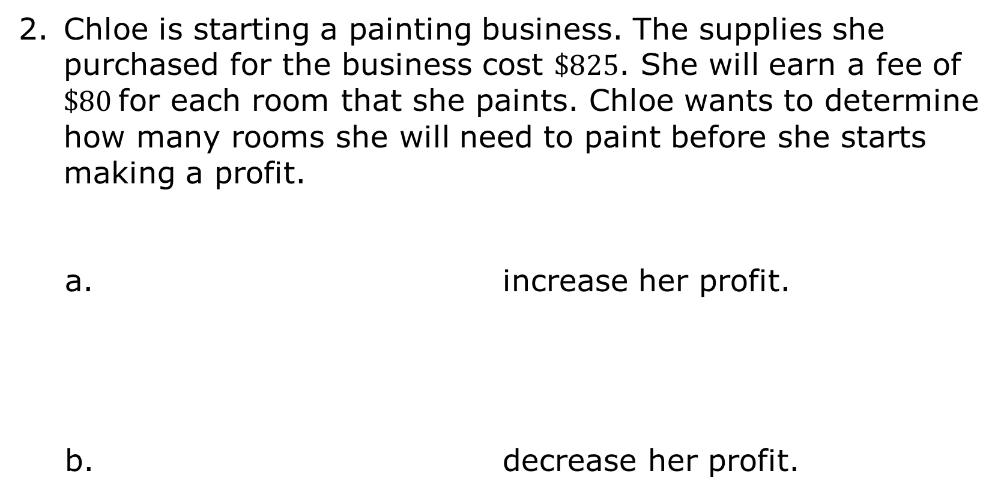
Chloe is starting a painting business. The supplies she purchased for the business cost $\$825$. She will earn a fee of $\$80$for each room that she paints. Chloe wants to determine how many rooms she will need to paint before she starts making a profit.
increase her profit.
decrease her profit.
volume 1, pg. 125

Slide 18


Write a value in the blank for each absolute value and a word in the remaining blank to complete each sentence.
To find the revenue, Chloe multiplies the number
of rooms she paints by
To find the profit, Chloe subtracts
from the _____________.
volume 1, pg. 125

Slide 19
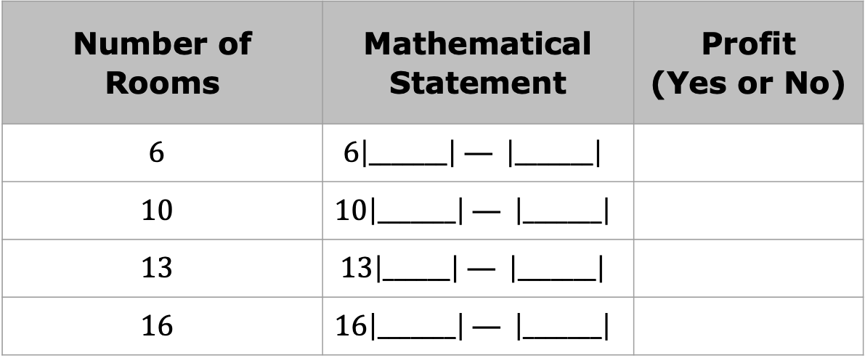
In the table, complete the mathematical statement and then perform the operations to determine if the number of rooms painted would result in a profit.
Number of Rooms | Mathematical Statement | Profit (Yes or No)
$$6$$ | $$6\left|_______\right| — \left|_______\right|$$
$$10$$ | $$10\left|_______\right| — \left|_______\right|$$
$$13$$ | $$13\left|______\right| — \left|_______\right|$$
$$16$$ | $$16\left|_______\right| — \left|_______\right|$$
volume 1, pg. 125

Slide 20

Try It
volume 1, pg. 126

Slide 21

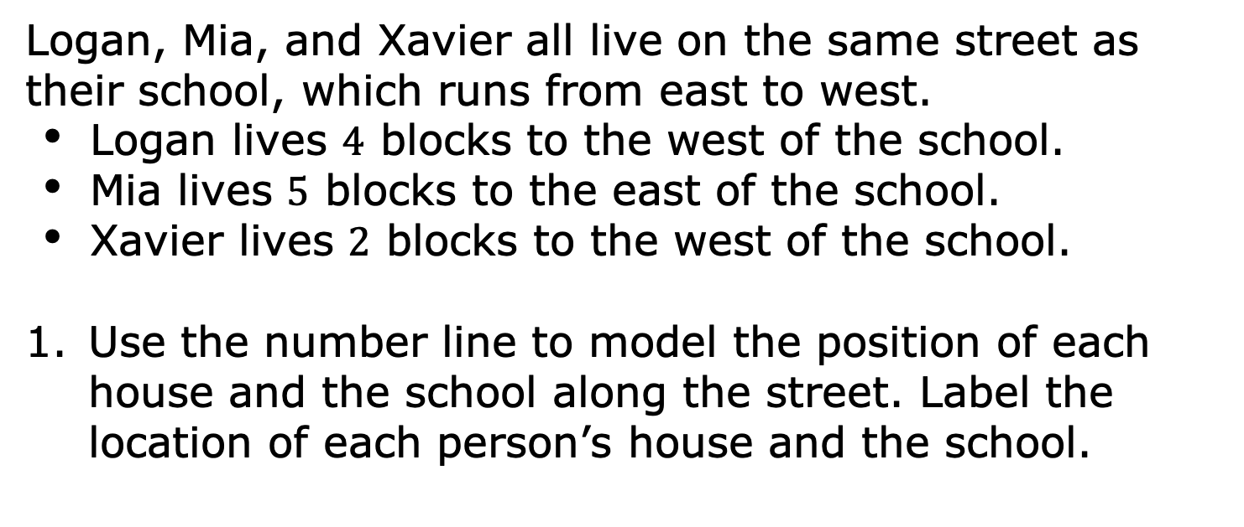
3.9.4 Try It: Operations With Absolute Value in the Real World
Logan, Mia, and Xavier all live on the same street as their school, which runs from east to west.
Logan lives $4$ blocks to the west of the school.
Mia lives $5$ blocks to the east of the school.
Xavier lives $2$ blocks to the west of the school.
Use the number line to model the position of each house and the school along the street. Label the location of each person’s house and the school.
volume 1, pg. 126

Slide 22
Work with your partner to write the mathematical sentence using absolute values. Then, use the mathematical sentence to determine each answer.
How far does Logan live from Mia?
How far does Mia live from Xavier?
How far does Xavier live from Logan?
Was the same operation used to find each distance?
volume 1, pg. 126

Slide 23
Collaboration
volume 1, pg. 126

Slide 24
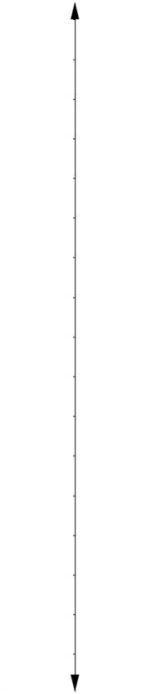
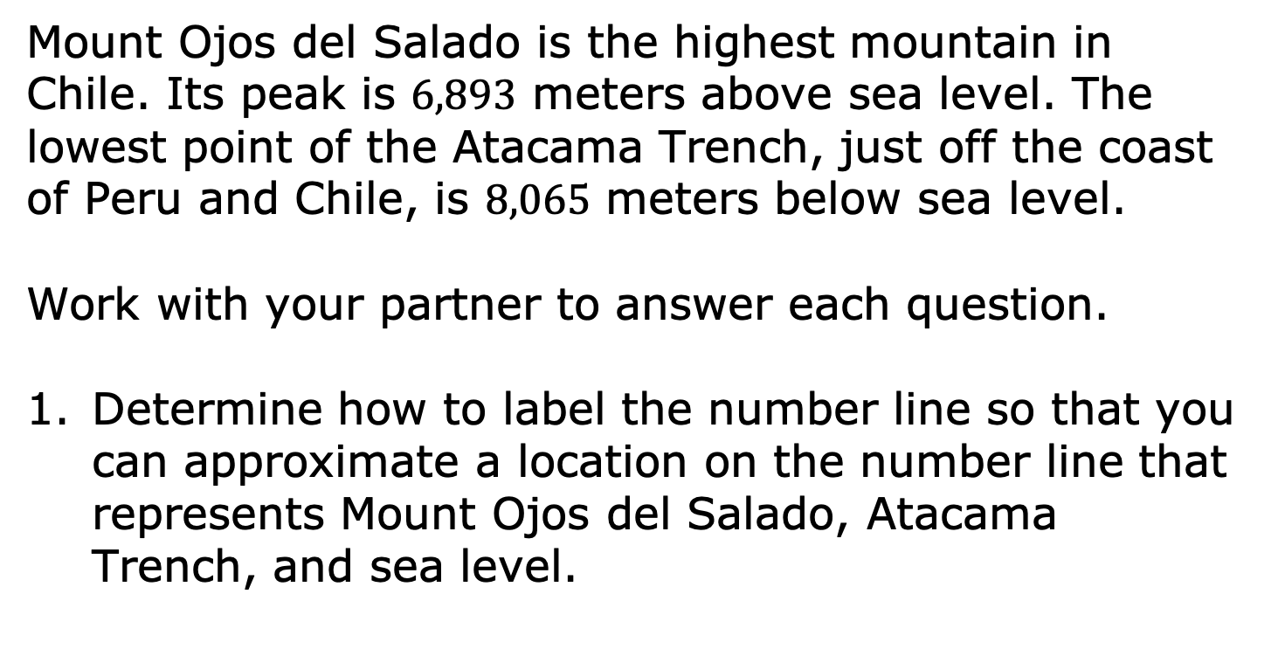
3.9.5 Collaboration: Halfway Point
Mount Ojos del Salado is the highest mountain in Chile. Its peak is $6,893$ meters above sea level. The lowest point of the Atacama Trench, just off the coast of Peru and Chile, is $8,065$ meters below sea level.
Work with your partner to answer each question.
Determine how to label the number line so that you can approximate a location on the number line that represents Mount Ojos del Salado, Atacama Trench, and sea level.
volume 1, pg. 126

Slide 25
Label the number line and place a point at the approximate location for Mount Ojos del Salado, Atacama Trench, and sea level.
Write a mathematical sentence using absolute value to find the difference in elevations between Mount Ojos del Salado and the Atacama Trench.
volume 1, pg. 126

Slide 26
With your partner, discuss how the halfway point between the peak of Mount Ojos del Salado and the Atacama Trench can be found. Write down all of the strategies that were discussed.
Explain how to determine if the halfway point’s elevation is above sea level or below sea level.
volume 1, pg. 127

Slide 27

Your Turn
volume 1, pg. 127

Slide 28
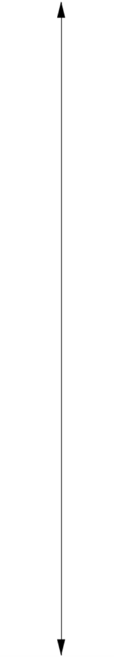
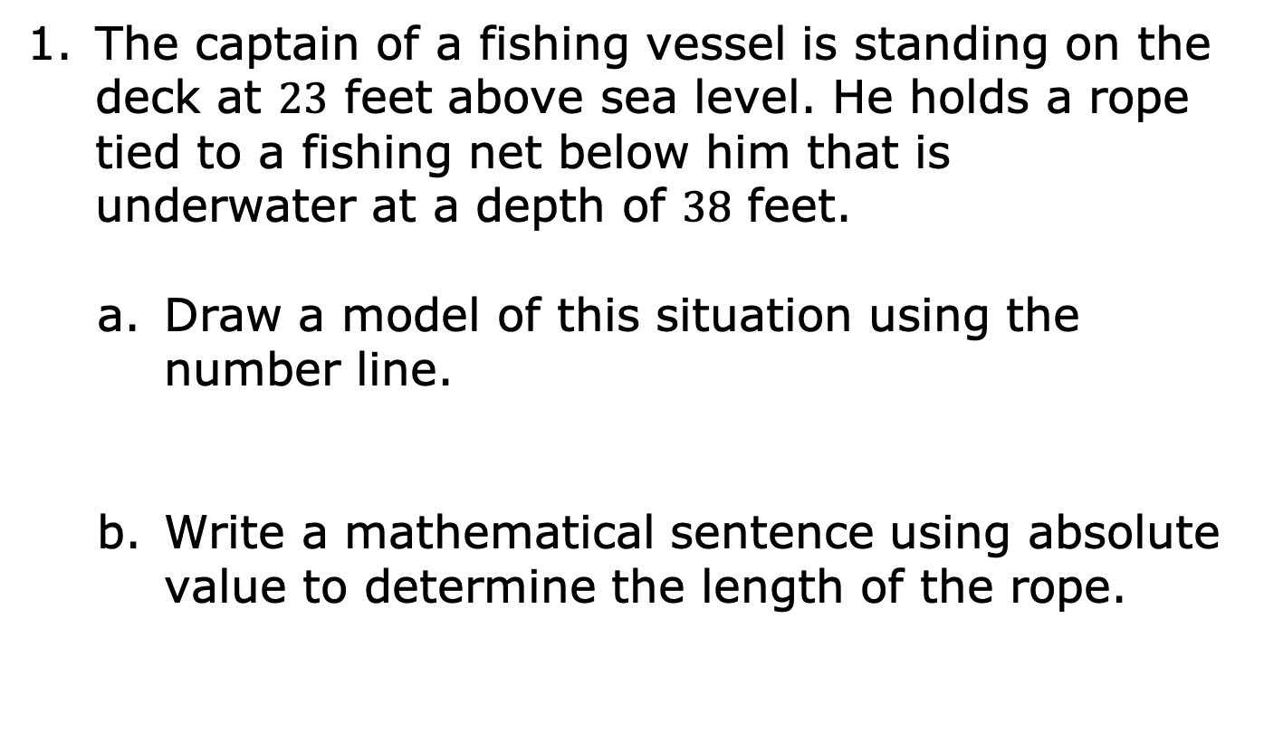
3.9.6 Your Turn!
The captain of a fishing vessel is standing on the deck at $23$ feet above sea level. He holds a rope tied to a fishing net below him that is underwater at a depth of $38$ feet.
Draw a model of this situation using the number line.
Write a mathematical sentence using absolute value to determine the length of the rope.
volume 1, pg. 127

Slide 29
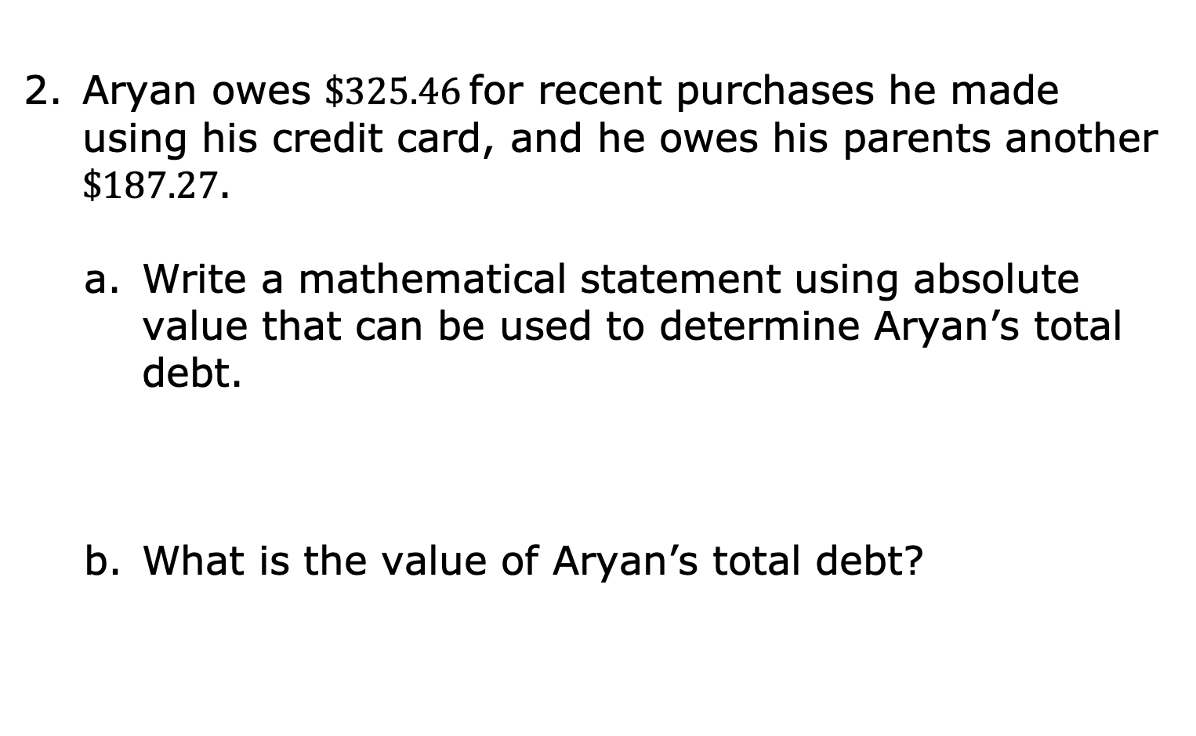
Aryan owes $\$325.46$for recent purchases he made using his credit card, and he owes his parents another $\$187.27$.
Write a mathematical statement using absolute value that can be used to determine Aryan’s total debt.
What is the value of Aryan’s total debt?
volume 1, pg. 128

Slide 30
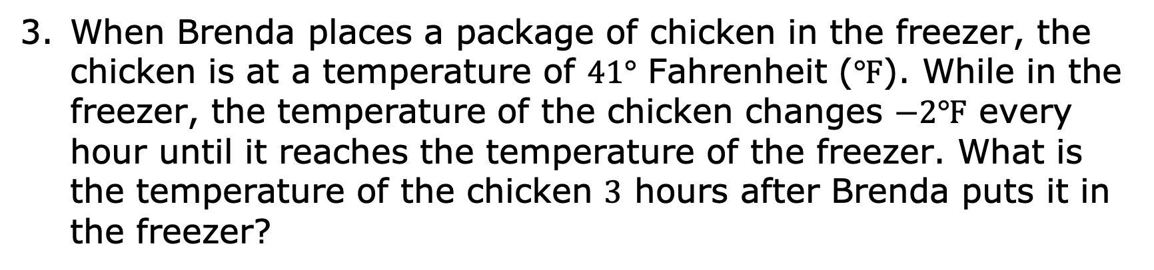
When Brenda places a package of chicken in the freezer, the chicken is at a temperature of $41°$ Fahrenheit ($℉$). While in the freezer, the temperature of the chicken changes $−2℉$ every hour until it reaches the temperature of the freezer. What is the temperature of the chicken $3$ hours after Brenda puts it in the freezer?
volume 1, pg. 128

Slide 31

Wrap-Up
volume 1, pg. 128

Slide 32
3.9.7 Wrap-Up: Reflection
Check all of the statements below that describe your understanding of and ability to work with absolute values.
I can compare the absolute value of two numbers.
I need support on how to compare the absolute value of two numbers.
I can perform operations that involve the absolute value of two numbers.
I need support to perform operations that involve absolute value.
volume 1, pg. 128

Slide 33
I can interpret comparisons of absolute values in real-world contexts.
I need support interpreting comparisons of absolute values in real-world contexts.
I can perform operations that involve absolute value when solving real-world problems.
I need support to perform operations that involve absolute value when solving real-world problems.
volume 1, pg. 128

